Slide 1

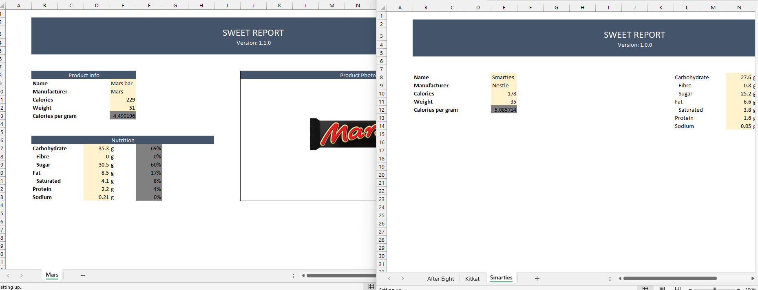
Bulk Structured Spreadsheet Extractor
built with
stdVBA
Different versions of the same report…
Define how to distinguish versions
Define how to extract data from versions
Generated report of data
Supports
Logic, Regex, Find text,
sheet access, OOP member access,
merge aware offset, extensions,
…

Slide 2
